Slide 1


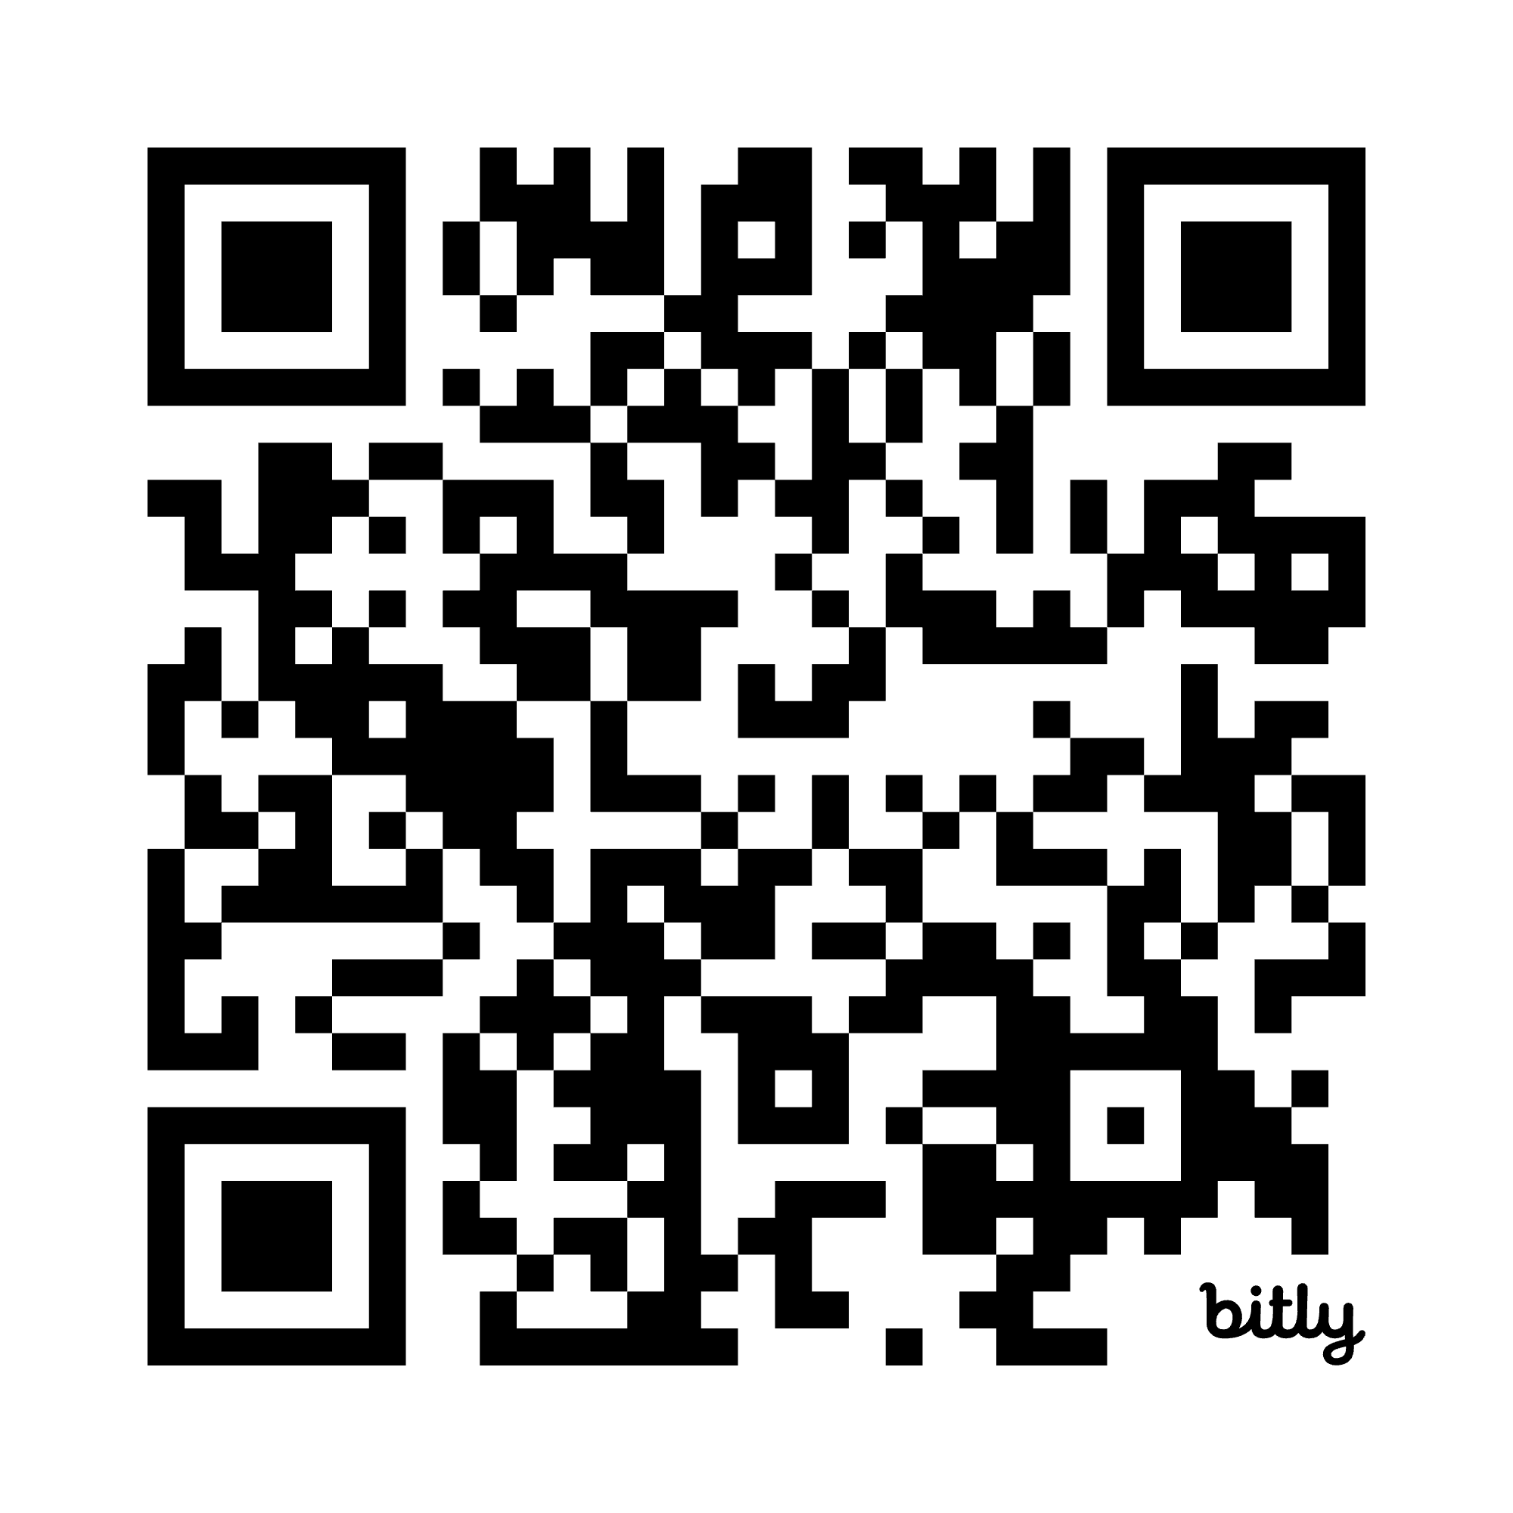
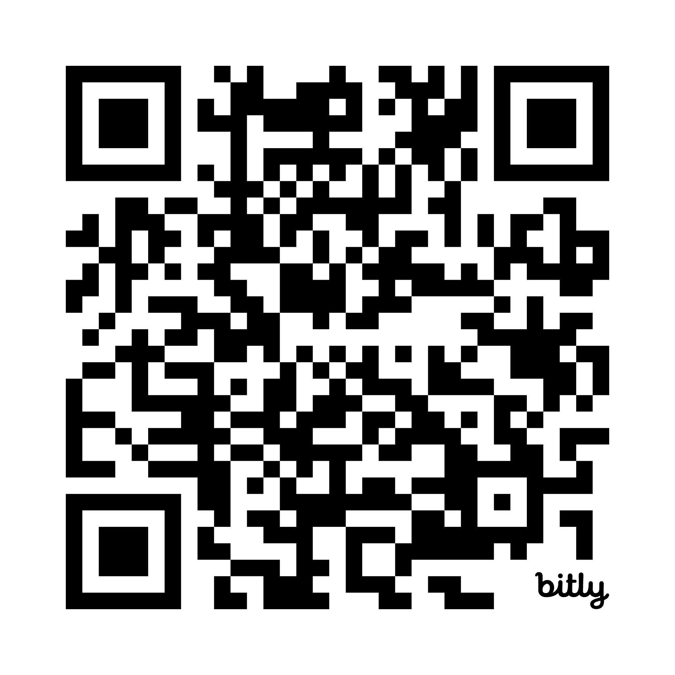
Giving good scientific talks
Kendrick Kay
kay@umn.edu • http://cvnlab.net
Center for Magnetic Resonance Research (CMRR)
University of Minnesota, Twin Cities
These slides:
More information:

Slide 2

What is the goal of a scientific talk?
The goal is to communicate information:
Why you did it
What you did
What you found
If you succeed (and if your science is interesting), people will want to read your papers, talk to you, & collaborate with you!

Slide 3

What makes a good talk?
It’s not just about clarity.
It’s also energy/engagement.
It inspires!
It excites!
It is entertaining!
It makes the audience care!
It engages the audience!
It sustains their attention!
Achieving this is not easy.
Science is technical and takes a lot of mental effort to process.
Talks can be long and tiring.
Scientists are not necessarily speakers / comedians / actors.

Slide 4

Designing a good talk
There are different types of talks (e.g., formal seminar, brief talk, tutorial, lab meeting, etc.); each requires a different approach.
Think about your audience.
Focus on the narrative. This is crucial.
General structure that applies to most cases:
Convey the motivation (Introduction)
Explain what you did (Methods)
Show what you found (Results)
Talk about the implications (Discussion)
This is just a scientific paper in a talk format!

Slide 5
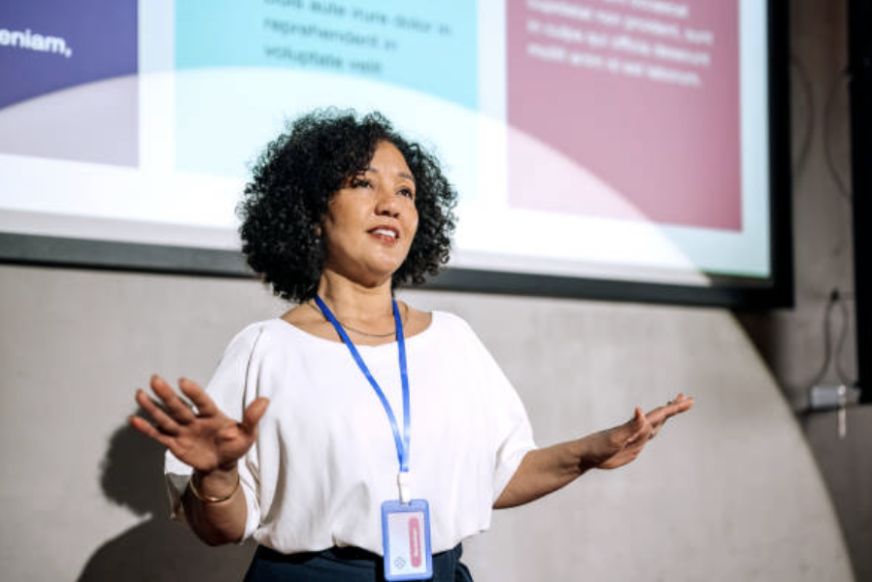

But, talks are not papers
Do not include all the details.
You can say things you wouldn’t say in a paper. (Be funny?, be provocative?)
Talks can include animations, movies, etc.
For papers, you can assume the reader is ready to make an effort. For talks, the listener may be tired and low-energy.
vs.

Slide 6
Tips
Minimize text.
Make your figures and text big/visible.
Explain your figures.
Talk about your intentions up front. (“Today, I’m going to...”)
Use good transitions.
Practice.
Record and listen to yourself.
Beat your listener over the head. (Attention span is low.)
Less is more. (Attention span is low.)
Focus on take-home messages. (Attention span is low.)
Get honest feedback. (Was the communication successful?)

Slide 7
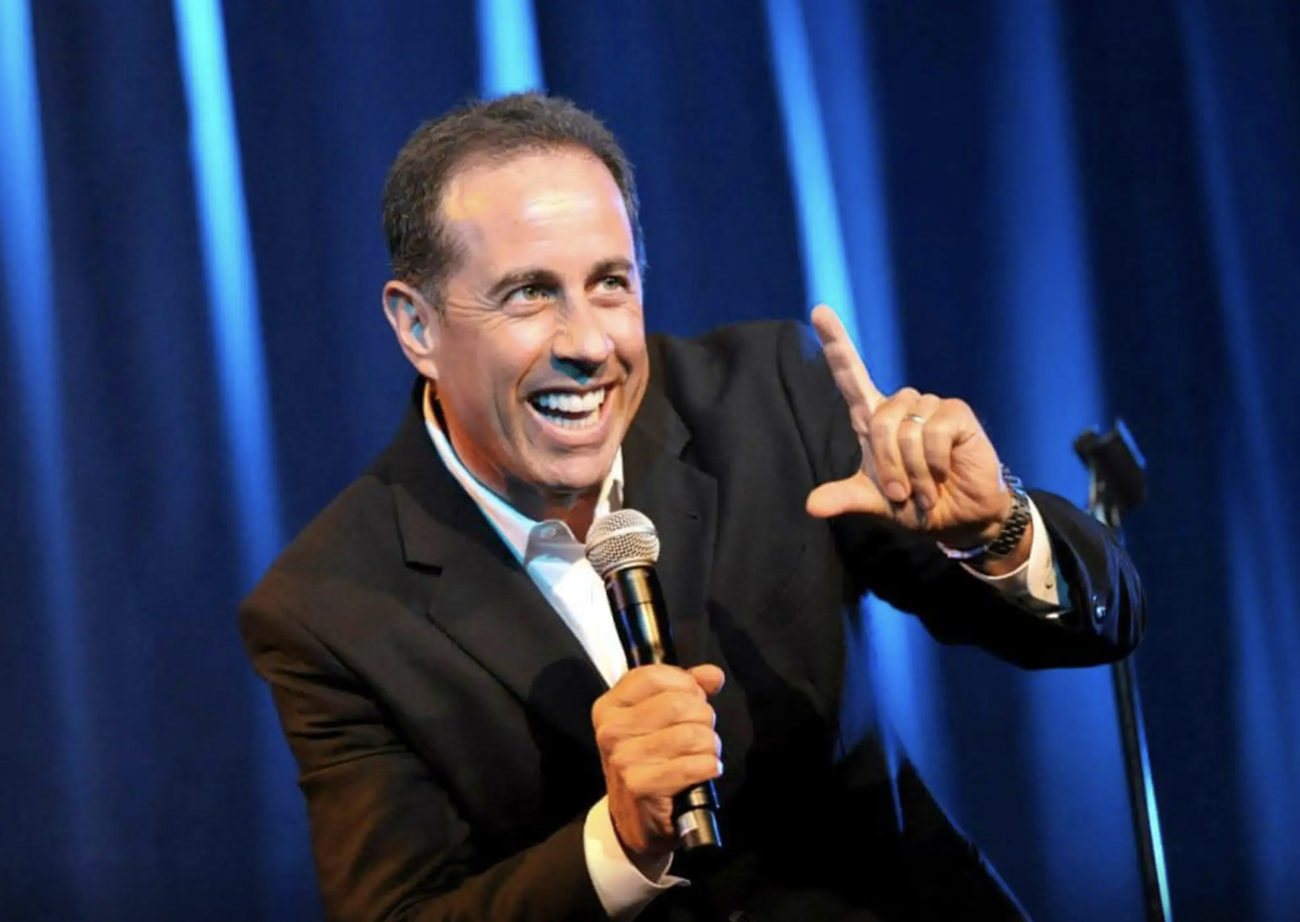
Expertise will come with time
Giving talks is a physical (and mental) performance.
Optimize vocal dynamics, emotion, nuance, flair.
Engage your audience, read the room.
Meet the audience where they are at.
Answer questions with mastery (be nice, restate the question, don’t be defensive).

Slide 8
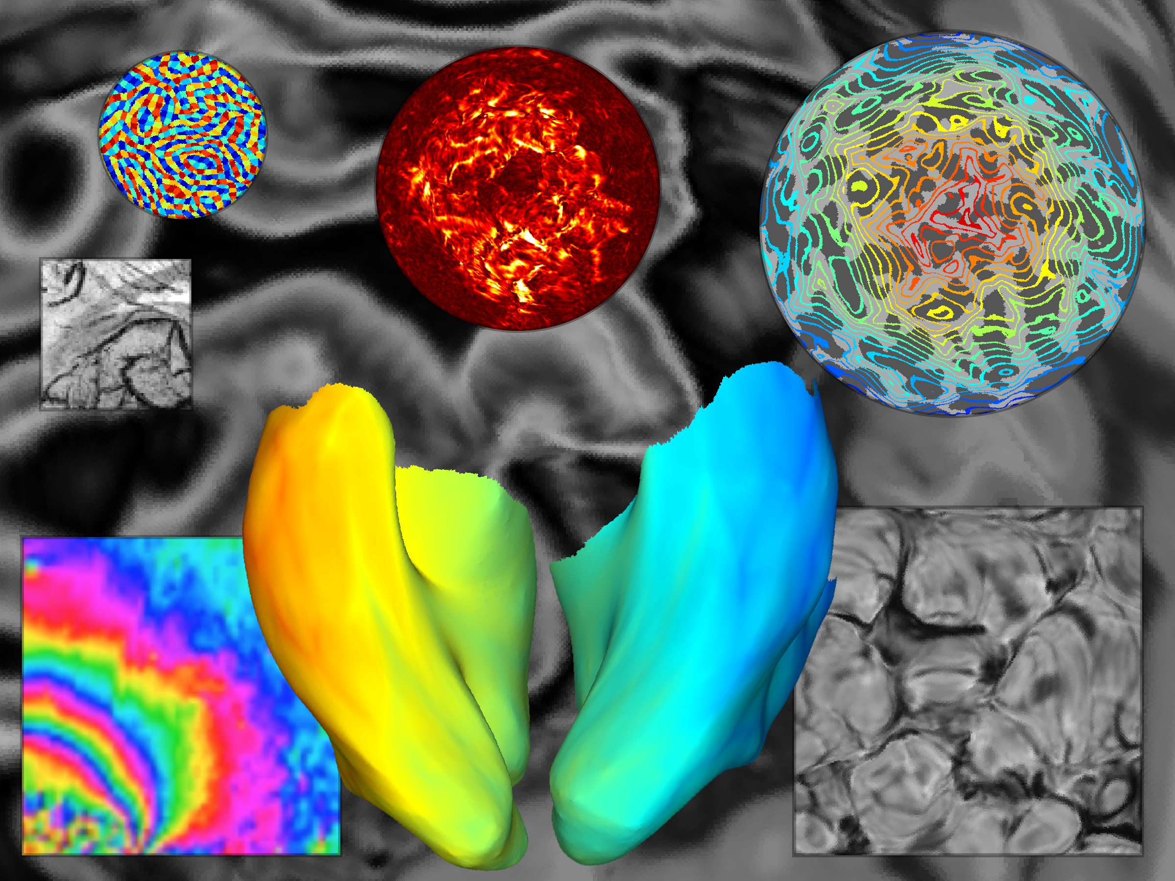
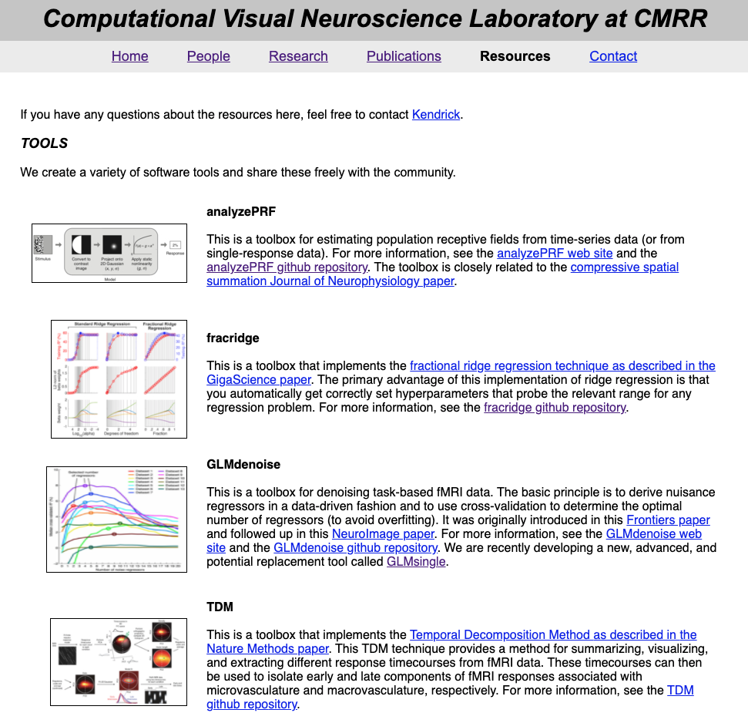
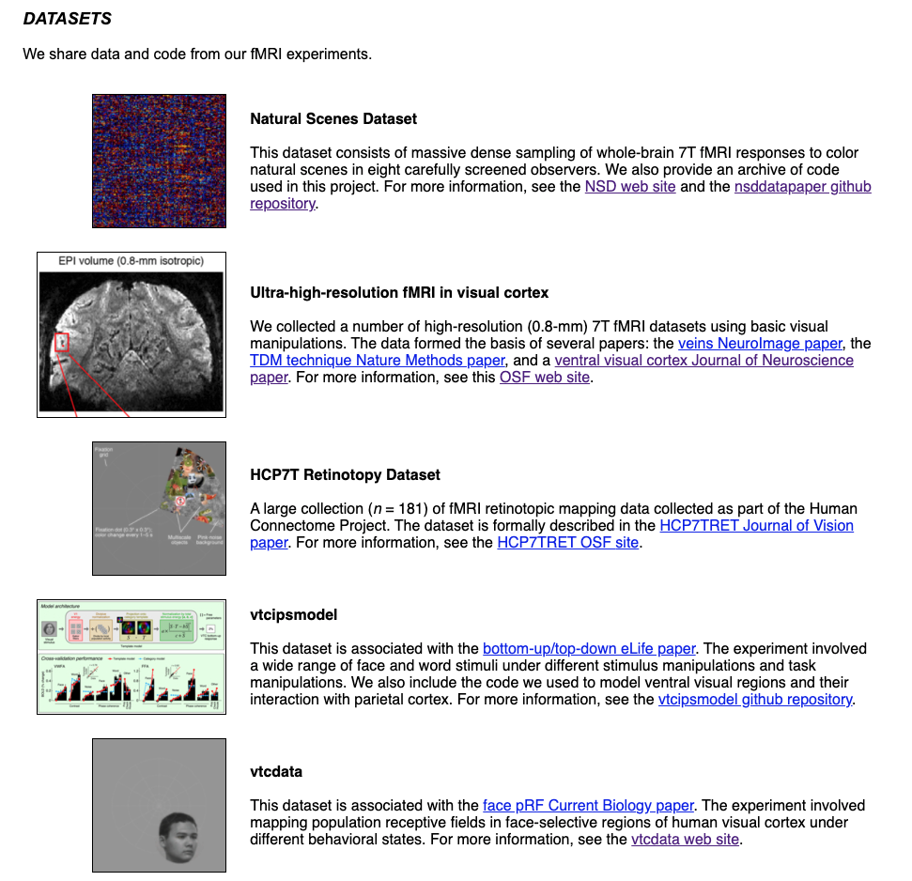
http://cvnlab.net
CODE
DATA

